Slide 1
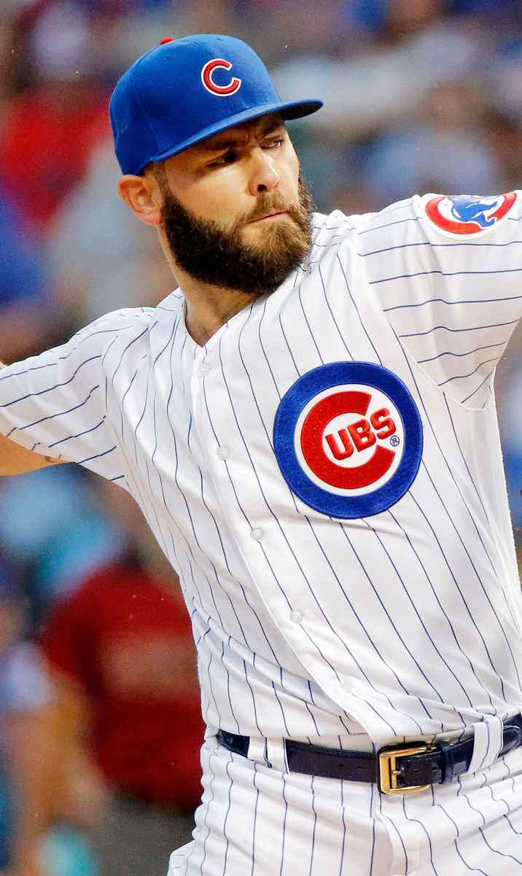
Predicting Starting Pitcher Salary
Chris Gillespie
Notes:
Good morning everybody, my name is Chris and for this project, I decided to predict salaries for starting pitchers in MLB.

Slide 2

Objective
Recommend Annual Salary for Free Agent Starting Pitcher to Chicago Cubs

Slide 3
Ballpark Strategy
Data
2017
Notes:
Pull 2017 pitching data from Baseball-Reference – approximately 800 records.

Slide 4
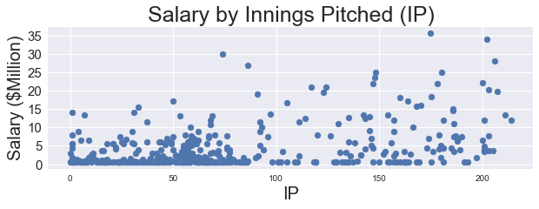
Focusing on Starting Pitchers
Data
Clean
Notes:
Plotting all players who pitched in 2017 that have a target value, which was roughly 400 out of 800 records.

Slide 5
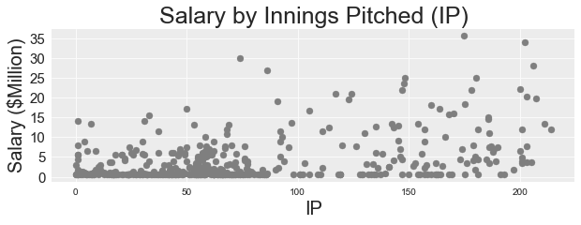
Focusing on Starting Pitchers
Data
Clean
Notes:
Focusing on Starting Pitchers – focusing on this sample eliminates injured pitchers, position players, and relief pitchers. To do this, I focused on pitchers with more than 4 games started. This brought my number of observations down to 182.

Slide 6
Focusing on Starting Pitchers
Data
Clean
Position Players
Notes:
Example of position players with large salaries that only pitched for 1 inning due to the team running out of available pitchers.

Slide 7
Annual Salary by Age
Data
Clean
Model
Notes:
Simple linear regression on my target population using age and annual salary.

Slide 8
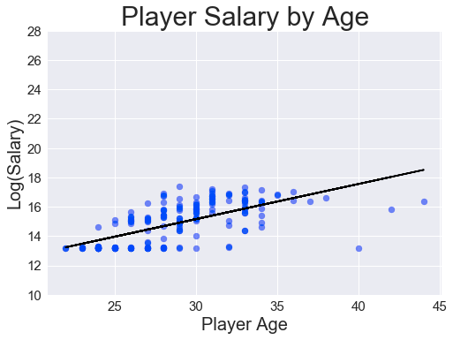
What if I Log Transform Salary?
Data
Clean
Model
Notes:
If I log transform salary to rein in high salaries, it improves my model.

Slide 9
Annual Salary Based on Age & IP
Data
Clean
Model
Notes:
When I back out of the log transformation of salary to make things more interpretable, it creates the hyperplane seen here.

Slide 10
Log(Salary) Based on Age & IP
Data
Clean
Model
Recommend
Predicted 2017 Salary: $5.64 Million
Notes:
Let’s apply my model to Yu Darvish to predict his salary. I also make a prediction for 2018 by increasing his age to 31 and keeping his IP constant.

Slide 11


Polynomial Features
Data
Clean
Model
Recommend
Predicted 2017 Salary: $7.48 Million
Notes:
I then attempted a polynomial transformation on the data to see if it improved my model and estimate. That process resulted in a recommendation of $7.48 million in 2017 for Darvish, which is a definite improvement.

Slide 12
Actual
Actual 2017 Salary: $11 Million
Notes:
Looks like all of my models recommended a significantly lower salary for Darvish.

Slide 13
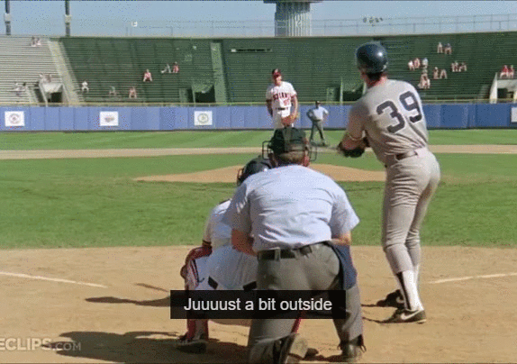
How Did I Do?

Slide 14
Further Investigation
5-year average statistics
Consider weighting years
Explore different feature transformations
Apply different model
Explore a model for relief pitchers

Slide 15
Appendix

Slide 16
Annual Salary by Age

Slide 17
Feature Pair Plot

Slide 18
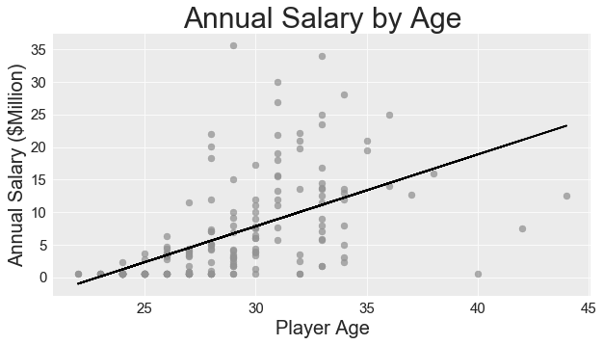
Annual Salary by Age
Data
Clean
Model
Salary = -25294882.33 + 1103499.55*Age
R^2= .3122

Slide 19
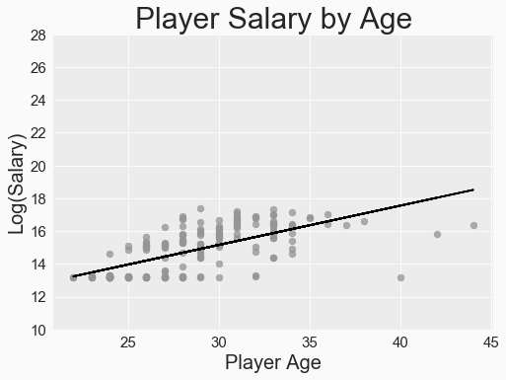
Annual Salary by Age
Data
Clean
Model
log(Salary) = 7.96 + .24*Age
R^2 = .4321
RMSE = 1.73

Slide 20
Log(Salary) Based on Age & IP
Data
Clean
Model
Notes:
After log transforming salary, I used Kfolds cross-validation on the two optimal features (Age & IP) to create a model, resulting in this hyperplane.

Slide 21
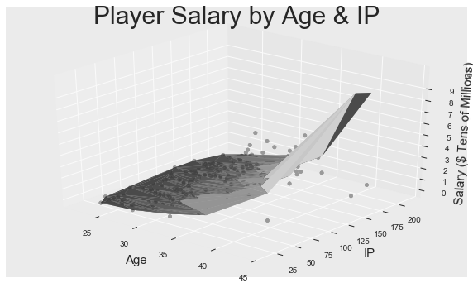
Annual Salary Based on Age & IP
Data
Clean
Model
log(Salary) = 7.46 + .227*Age + .007*IP
RMSE = 1.62

Slide 22
Polynomial Features Residuals

